Slide 1
Fishbone Diagram (Defective fuel pump)
Masters in Data Science

Slide 2
Case Study
Quality can be directly measured from the degree to which customer requirements are satisfied. Some problems were reported by the customers of the automobile company under study in the fuel pumps; which is used in an automobile to transfer the fuel from fuel tank to fuel injection system after filtration.
The automobile industry under consideration is one of the biggest automobile industries in the world. The plant in which study was conducted is situated in western part of the India. It manufactures automobiles in the category of passenger vehicles. The fuel pump used in the passenger vehicle of the company is an out-sourced part; manufactured by a different supplier. The dealers of the company’s cars used to replace the defected fuel pump in customers‟ cars with the new one. The defected fuel pumps were then received back at the plant for analysis purpose.

Slide 3
The fuel pump intakes fuel from the fuel tank. The fuel pressure is increased to specified value by compression (by gear motor) or transfer of momentum (by turbine) which is controlled by a pressure regulator. Then, the fuel pump transfers the fuel at a higher pressure to the engine fuel injectors through supply lines. A pressure regulator sets the fuel pressure. It consists of an air chamber, a diaphragm with relief valve assembly and a regulator spring. As the fuel injector spray tip is exposed to regular changes in the pressure of air inside intake port, the regulator varies fuel pressure and hence, maintains a constant pressure drop across the fuel injector. Relief valve prevents the rise of excessive pressure in case the fuel lines are blocked. Besides, a check valve is incorporated to isolate the system when the pump is turned off.
Create a fishbone diagram to find the causes of the defect. Categories should be related to the problem statement. Only presentation is to be made.

Slide 4
Parameters of defects and best possible causes
Material
Bad quality of materials
Improper installation
Loose parts
People
Bad quality checks
Unsatisfied staff
Untrained staff
Long Working Shifts
Low facilities to staff
Demotivated staff
Method
Wrong Valve Position
Bad Startup procedure
Environment
Bad Temperature
Bad air pressure

Slide 5
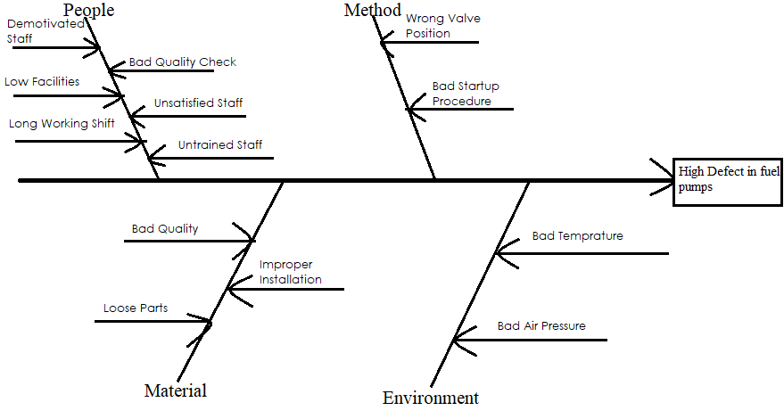
Fishbone Diagram

